Slide 1
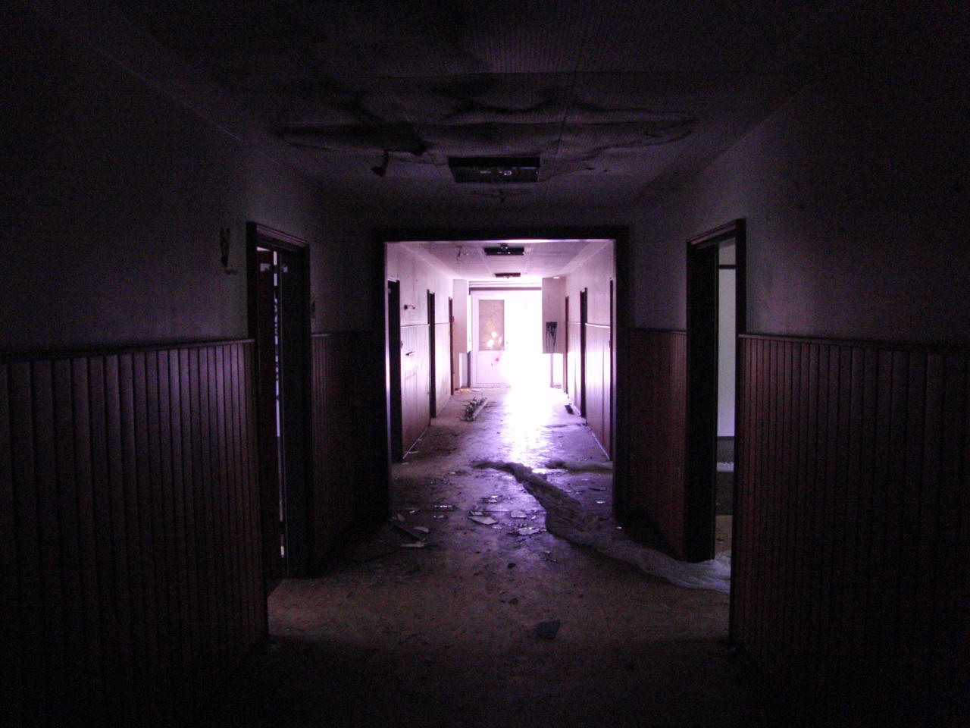
Haunted hospital
Group 20

Slide 2

Game Overview
Our game is a maze game called “Haunted Hospital”. There will be a main character who will need to collect all rewards (key cards) in order to open the exit door. There will also be a starting point of score 100 that keeps decreasing as times goes. There will be bonus rewards(candy) which can help increase the score and traps (blood stain) which decrease your score. If the score goes to 0, you lose. Throughout the game, there will be two types of enemies which are ghosts(can go through walls) and demons (can’t go through walls), which can cause you to be lost directly when colliding.

Slide 3
Software design & architecture
UML Design
Our game design is divided into 4 parts which are entity, main, object, and tile. All of them are connected into the GamePanel which serves as our main class.

Slide 4
Implementation& testing
UNIT TESTING
We start by creating a testing file for each class that we have.
Integration TESTING
Then, we deep into integration testing making sure that the test across components working properly
Coverage
Lastly, we run the coverage using Jacoco and try to aim a higher line & branch coverage by looking into the code part that not being covered yet

Slide 5
Biggest challenge
Enemy algorithm
Testing phase
Tile drawing
We come up with several options of algorithm and decide to use A* algorithm because we think that it is more reasonable to use for this project
Hard to implement as our code has a quite high dependencies and we do lots of refactoring during this phase
Drawing tile is time consuming and need to import the right image

Slide 6
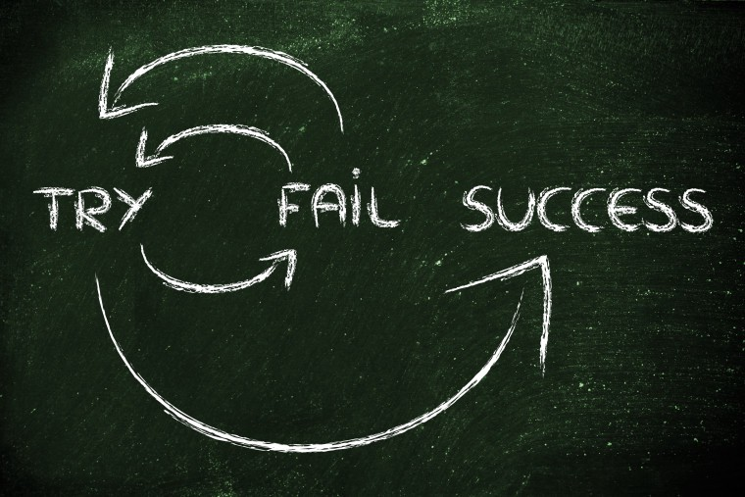
WHAT WE LEARNT
Time Management​
Having a good time management is important and not leave the assignment close to deadline resulting in not maximize result
Good planning​
Knowing how the structure of overall code is important to avoid spaghetti code which has a high dependencies resulting in lots of refactoring
Communication​
Having a good communication is important to avoid overdoing some tasks that others already doing it.
Pair programming
Having someone to check you code is important to make our code better and get some feedback from team members, while also making sure others can easily understand our code

Slide 7

Credits 1. liam Cummings 2. jea oh lee 3. ryan martin 4. ryan mitchellin

